Slide 1


INSURANCE ANALYTICS
Probability Course - Sekolah Data Pacmann
pacmann.io
© 2022 – Pacmann AI

Slide 2
Outline
Introduction
Dataset
Descriptive Statistic Analysis
Categorical Variables Analysis
Continuous Variables Analysis
Variables Correlation
Hypothesis Testing
Conclusion

Slide 3
Introduction
Notes:
Transisi antar outline

Slide 4
Introduction
Part of my motivation for this project is I wanted to explore my own ability in analyzing data with the Probability subject I had learnt from Pacmann. Although I lack the experience to do this kind of thing, I believe my will to learn, to try, and to fail should be bigger than my own fear to finish the given tasks. By finishing the project, I hope I can gain some feedback to improve the way I apply Probability in managing data. Thank you for facilitating all of the students, dear Pacmann. Thank you for the project.

Slide 5
Dataset
Notes:
Transisi antar outline

Slide 6
Dataset
Health insurance is one of the things that should be considered because it is related to health insurance future planning needs. Health insurance users are required to pay the amount of money regularly (premiums) to the insurance company. Premium processed by the insurance company to pay the user's health bill the insured. Determining the premium value is a challenge for the insurer considering there are many factors that can influence & increase the risk profile user.
Through this project, I’ll analyze the variables that has a relationship with the health bill received by each user. It was given data containing user personal data such as age, gender, place of residence the user, the number of children covered by insurance, the BMI value, the state of smoking or not user.

Slide 7
Descriptive Statistics Analysis
Notes:
Transisi antar outline

Slide 8
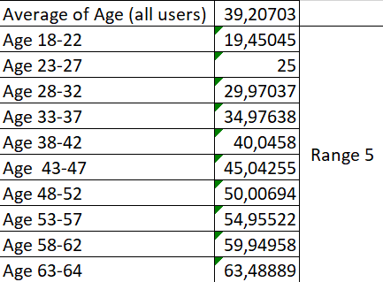
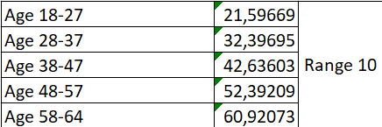
Average age in the data
When looking for an average number of the whole users, it is found that the Average Age is 39,2. When we look closely and divide every age within range 5, every range have different Average Age. So is when the range is changed to 10.

Slide 9
The average BMI of smokers
Average BMI smokers only: 30,65202551

Slide 10
The average age of women and men who smokes
The average age
Women 27,6346516
Men 47,08281054

Slide 11
Variance of data charge smokers and non-smokers
Varian
Smokers: 146.733.433
Non-smokers: 145.743.557

Slide 12
Who has the highest? BMI of smokers or non-smokers
Average BMI
Smokers: 30,65202551
Non-smokers: 30,66385105

Slide 13
Analysis
Interpretation
Dataset yang dipakai, diambil dari 1338 orang yang memiliki rata-rata umur 39,2 tahun. Rata-rata nilai BMI mereka adalah 30,66339686, ini menunjukkan rata-rata orang memiliki BMI obesitas. Selain itu, rata-rata BMI dari bukan perokok sedikit lebih tinggi daripada perokok.
Rata-rata usia yang merokok pada perempuan di angka 27 tahun yang mana tergolong lebih muda disbanding pada laki-laki yang berada di usia 47 tahun.
Varian tagihannya memiliki perbedaan yang tidak terlalu signifikan antara perokok dan bukan perokok, tepatnya memiliki selisih sekitar 989.876 (hanya 1 % dari total varian masing-masing kategori).

Slide 14
Categorical Variables Analysis
Notes:
Transisi antar outline

Slide 15
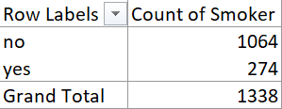
Proporsion of smokers and non-smokers
Non-smokers have the highest proportion compared to smokers.

Slide 16
Which gender has the highest bill?
Total bill
Women 8.321.061
Men 9.434.764

Slide 17
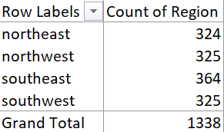
Does each region have the same proportion of people's data?
Southeast has the highest proportion, meanwhile for the rest of the regions have the same proportion.

Slide 18
Distribution of billing probability in each region
Region Sum of Charges
Northeast 4.343.669
Northwest 4.035.712
Southeast 5.363.690
Southwest 4.012.755
Grand Total 17.755.825
Billing probability
Northeast 0,244633442
Northwest 0,227289467
Southeast 0,302080572
Southwest 0,225996519

Slide 19
Probability that the person is a woman and is known to be a smoker
 | Smoker | Non-smoker
Female | 115 | 547 | 662
Male | 159 | 517 | 676
 | 274 | 1064
Probability that the person is a woman and is known to be a smoker:
0,419708029

Slide 20
Analysis
Interpretation
From the data can be gathered that non-smokers have the highest proportion compared to smokers, 4:1 proportional difference. Probability that the person is a woman and is known to be a smoker is 0,42; lower than man. Besides, despite they are smokers or non-smokers, men have higher amount of bills compared to women.
As for the proportion of each region of people’s data, Southeast has the highest proportion, meanwhile for the rest of the regions have the same proportion.
The distribution of billing probability in each region has Southeast as a region with the highest probability than the rest of the regions.

Slide 21
Continuous Variables Analysis
Notes:
Transisi antar outline

Slide 22
Billing probability based on BMI
The categorical of BMI was divided each in the range of 5. There are these top 3 BMI with the highest billing probability, they are:
31-35 with probability 0,3
26-30 with probability 0,26
36-40 with probability 0,18

Slide 23
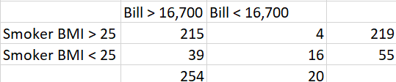
The probability a smoker with a BMI above 25 will get a health bill above 16,700.
First the data should be filtered to the people with BMI data > 25 and get health bill >16,700. Total amount of the people with those category is 215. Then it’s divided with 1338 (total amount of data), we get the probability 0,16.

Slide 24
The probability that a random person whose medical bill is over 16.7k is known to be a smoker
First the data should be filtered to the smoker with bill data > 16.7, there are 254 people. Total of the smokers are 274, so the probability should be written 254/274 = 0,92 which means it has a high rate of probability.

Slide 25
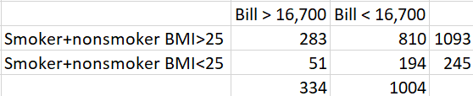
BMI vs Smokers
Which one is more probable
Someone has high BMI > 25 given he has high charges > 16.7k or
Someone has low BMI < 25 given he has high charges > 16.7k
From the data below, option 1 has 283 people on its category which means it has probability rate of 0,85. As for option 2 it has probability rate of 0,15. It is more probable to have option 1 as the answer for this case.

Slide 26
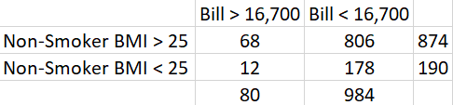
BMI vs Smokers
Which one is more probable:
Smoker has high BMI > 25 given he has high charges > 16.7K
Non-smoker has high BMI > 25 given he has high charges >16.7K?
Based on the data that has been previously gathered, option 1 has probability rate of 0,84 (215/254); meanwhile option 2 has probability rate of 0,85 (68/80) which means option 2 has slightly higher probability than option 1.

Slide 27
Analysis
Interpretation:
From the data we discovered that there are top 3 BMI with the highest billing probability, they are BMI with the range of:
31-35 with probability 0,3
26-30 with probability 0,26
36-40 with probability 0,18
The probability of a smoker with a BMI above 25 will get a health bill above 16,700 is 0,16 which has pretty-low rate of probability.
The probability that a random person whose medical bill is over 16.7k known to be a smoker is 0,92 which means it has a high rate of probability.
It is more probable to have someone has high BMI > 25 given he has high charges > 16.7k than someone has low BMI < 25 given he has high charges > 16.7k. Also, non-smoker withBMI > 25 given he has high charges >16.7K has slightly higher probability than smoker has high BMI > 25 given he has high charges > 16.7K.

Slide 28
Variables Correlation
Notes:
Transisi antar outline

Slide 29
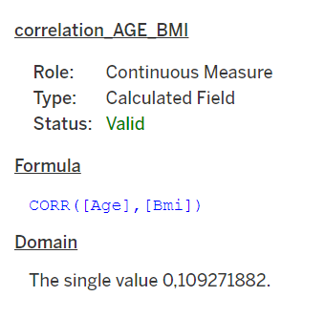
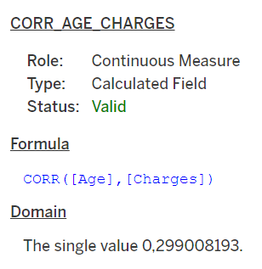
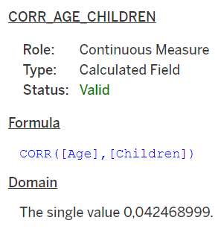
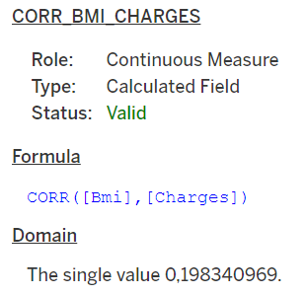
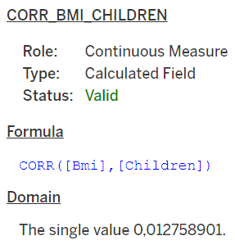
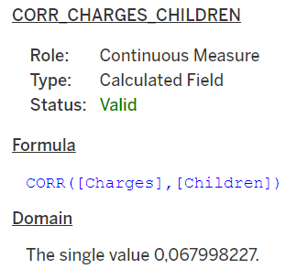
Correlation

Slide 30
Hypothesis Testing
Notes:
Transisi antar outline

Slide 31
Smoker’s charges are higher than non-smoker’s
H0: Smoker’s charges are equal to non-smoker’s
H1: Smoker’s charges are higher than non-smoker’s
The amount of smoker’s charges costs around 17.745.160 meanwhile for non-smoker’s charges costs 17.679.321 (charges of smokers higher than non-smokers)
Based on the result can be concluded that we should reject H0

Slide 32
Health charges with a BMI > 25 are higher than health charges with a BMI < 25
Ho: Health charges with a BMI > 25 are equal to health charges with a BMI < 25
Ha: Health charges with a BMI > 25 are higher than health charges with a BMI < 25
The amount charges people with BMI > 25 costs around 17.728.898 meanwhile for people with < BMI charges costs 17.689.512 (charges BMI >25 higher than BMI < 25)
Based on the result can be concluded that we should reject H0

Slide 33
Men’s health charges higher than women
Ho: Men’s health charges lower than women
Ha: Men’s health charges higher than women
Health charge for men costs around 9.434.764 meanwhile for women costs around 8.321.061 (charges men higher than women).
Based on the result can be concluded that we should reject H0.

Slide 34
Conclusion
Notes:
Transisi antar outline

Slide 35
Conclusion
From the hypothesis that has been analyzed before, we can conclude that health charges were divided into several categories. There are based on gender, BWI, and smoker or non-smoker. People with BMI > 25, people who smoke, and men in general, each category has higher rate charges of health bill than the opposite category.

Slide 36
Notes
Skills on running Python.

